Slide 1

Capstone Project on Pneumonia Detection
INTERIM REPORT
Participants
Mrs Shilpa Kulkarni
Mr Jignesh Mistry
Mr Samit Biswas
Mr Aarish Shahab

Slide 2
Pneumonia and Diagnosis
Pneumonia is an infection of the lungs caused by bacteria, viruses and fungi. Pneumonia causes inflammation in the air sacs of one or both lungs which fill with fluid or pus, making it difficult to breathe and may result in fatality.
World Health Organization (WHO) estimates, approximately 150 million lung infections and 4 million deaths can be attributed annually to Pneumonia. Small children and seniors are more susceptible to this infection. Fast, timely and accurate diagnosis is of utmost importance.
Chest X-Ray (CXR) analysis is the first step in the diagnosis of Pneumonia.

Slide 3
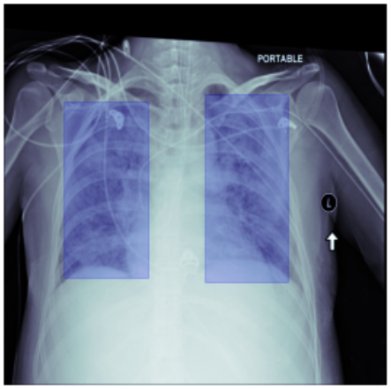
Problem Statement:
The goal of this project is to build a model which detects if a given patient’s CXR image indicates the presence of Pneumonia or not and also predicts the location of the Pneumonic patch. Both, accuracy and speed of detection are of utmost importance.
To achieve these, we performed object (opacity) detection using a Neural Network(NN) with labelled samples of Chest X-Ray(CXR) images.

Slide 4
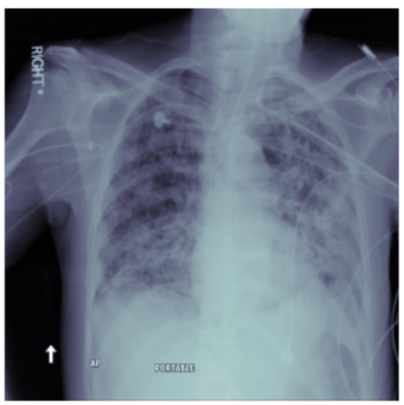
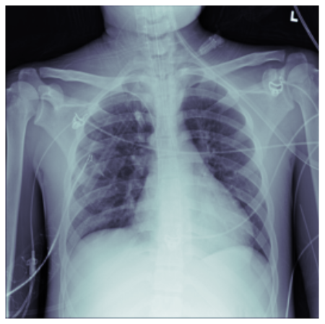
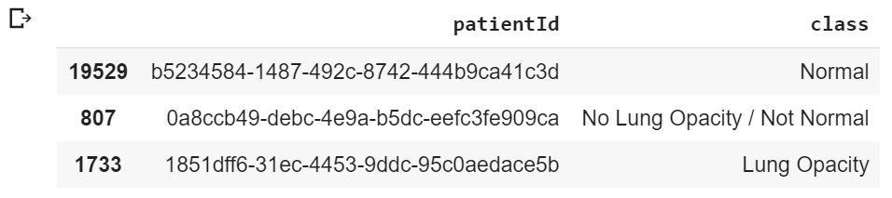
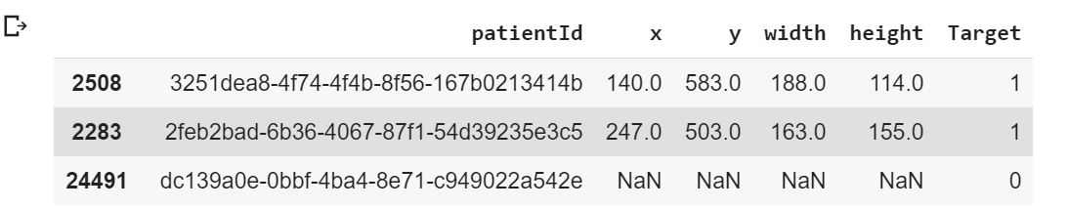
Data:
Train and Test Images - The CXR images are present in the Digital Imaging and Communications in Medicine (DICOM) format, with .dcm file extension. They are separated into training and test sets
Patients by class - A .csv file which has information about the class detected per patient is provided
Training labels – A .csv file with co-ordinates for each bounding box per patient is provided.

Slide 5
EDA, Pre-processing and findings

Slide 6
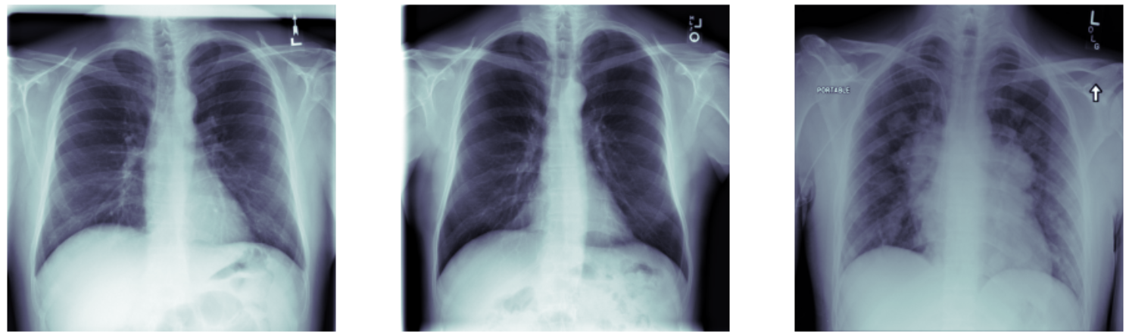
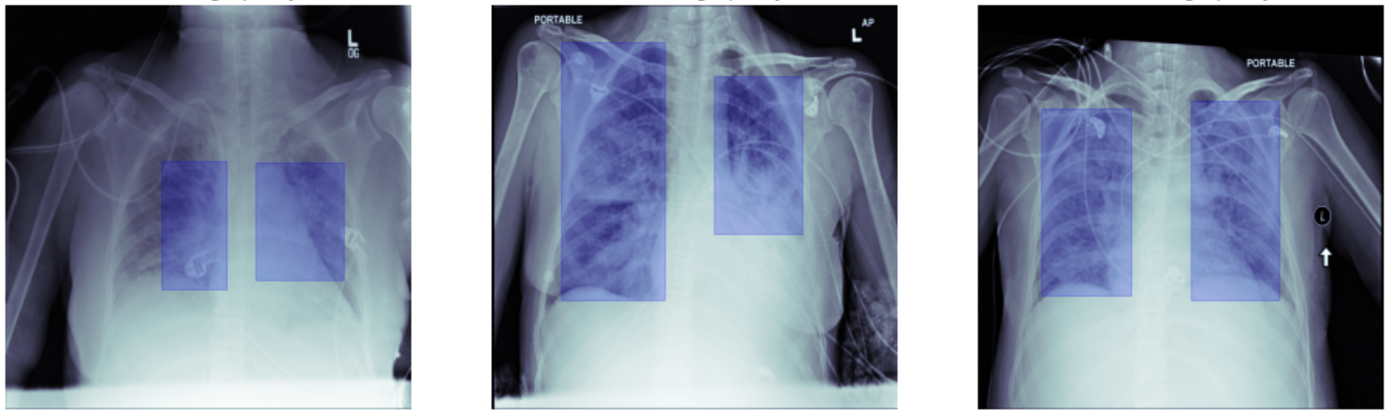
Approach to EDA:
Row counts: There are same number of rows in both .csv files
There are multiple entries for some patients
Target Values are 0 (Non-Pneumonic) and 1 (Pneumonic)
2 target values are mapped to 3 class values
Target 0 is mapped to “Normal” & “No Lung Opacity/Not Normal” classes
Target 1 is mapped to “Lung Opacity” class

Slide 7
Approach to EDA:
Used pydicom package to load the .dcm images from the training dataset and visualized samples positive as well as negative cases.

Slide 8
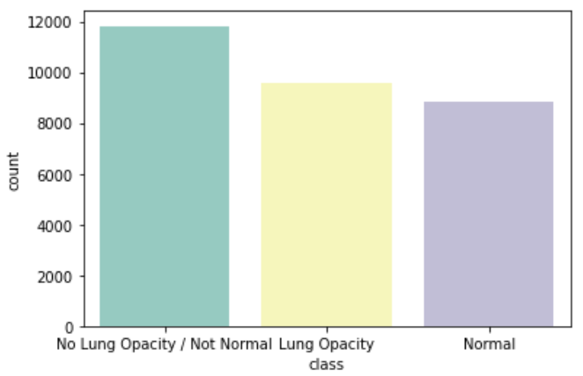
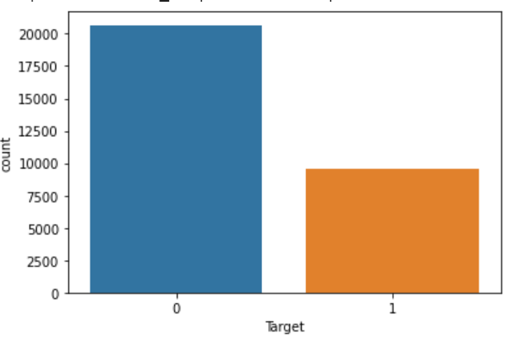
Approach to EDA:
Missing Values:
Class Details – There are no missing values
Training Labels:
68.3% of the data is missing values in columns x, y, width and height where Target = 0 (non-Pneumonia)
For 31.3% of data, there are no missing values where Target = 1
Check for Class imbalance
No noticeable difference between row counts for classes (Normal, No Lung Opacity/Not Normal, Lung Opacity)
Target=0 includes 2 classes, only 31%.

Slide 9
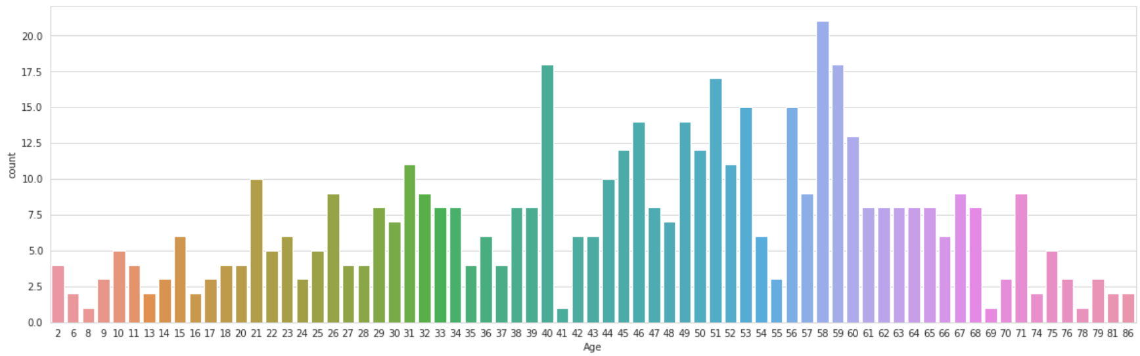
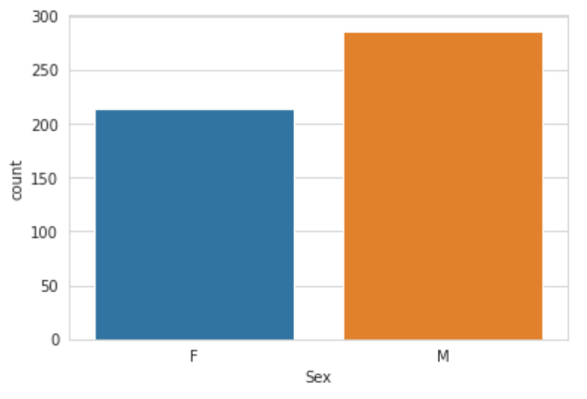
Approach to EDA:
Maximum number of cases lies between 40 to 60 (for 500 random samples).
Normally distributed.
Occurrence is more in male patients than female patients

Slide 10
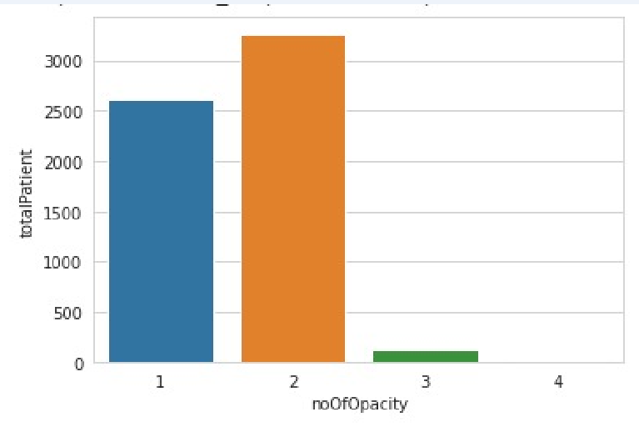
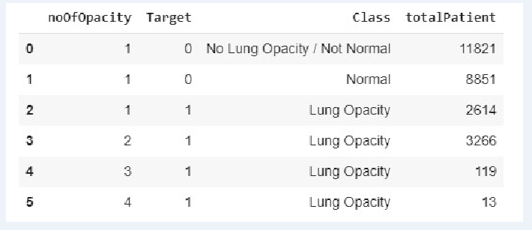
Approach to EDA:
Frequency of 2 bounding box (opacity) is higher

Slide 11
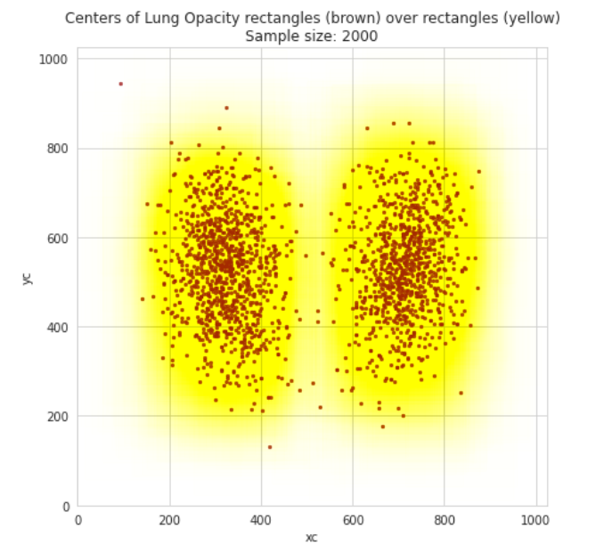
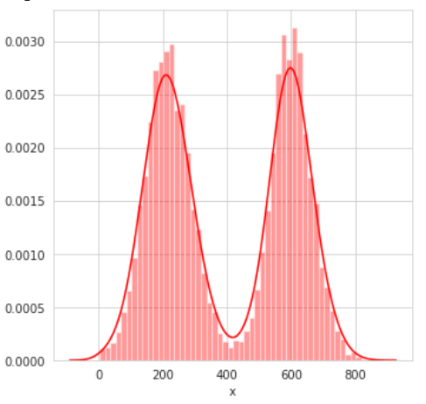
Approach to EDA:
Analyse the Lung Opacity Window
For 2000 samples of training data, plotted the centres of the bounding boxes (bbox) for lung opacities over the actual boxes.
Probability is pneumonic patch is more around the centre of both the lungs .

Slide 12
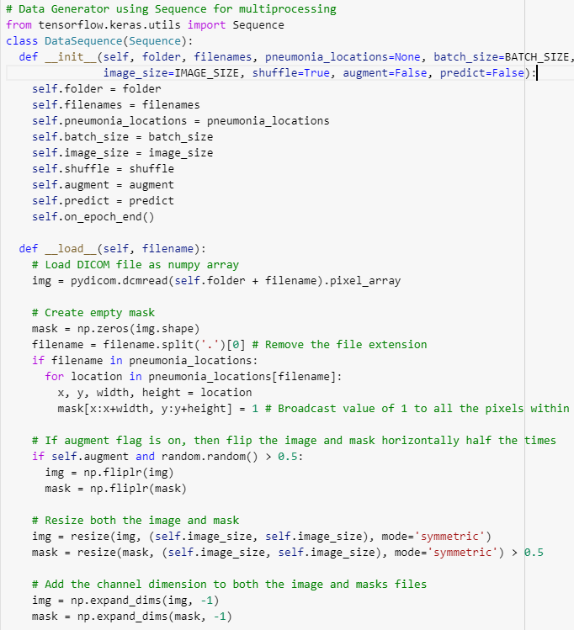
Data Pre-processing

Slide 13
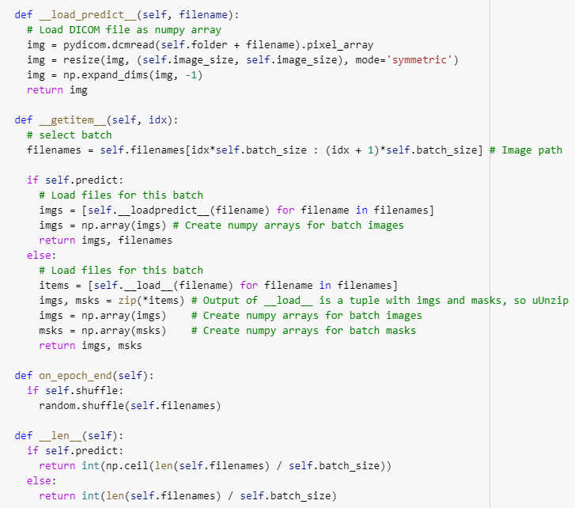
Data Pre-processing

Slide 14
Models Used
Model with Conv2D Layers
Model with SeparableConv2D Layers
Model with SeparableConv2D Layers additional layers
Model with Resnet Blocks
Model for Classification with SeparableConv2D Layers

Slide 15
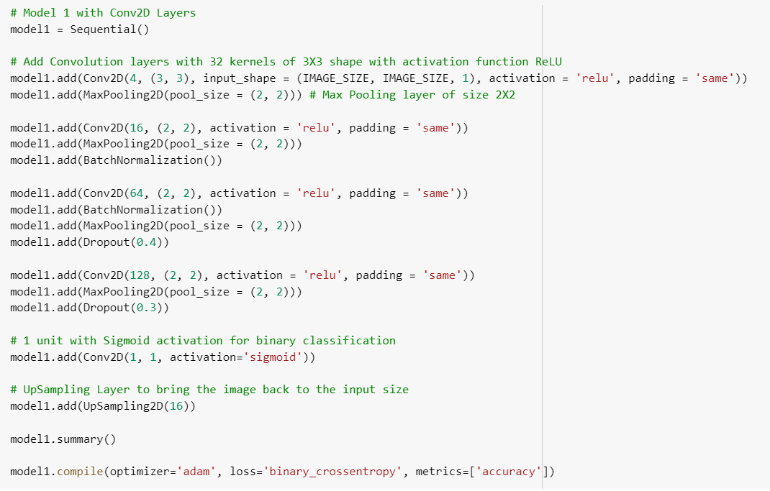
Deciding Models and Model Building
Model 1 with Conv2D Layers
Training accuracy : 97.34%
Validation accuracy : 97.55%

Slide 16
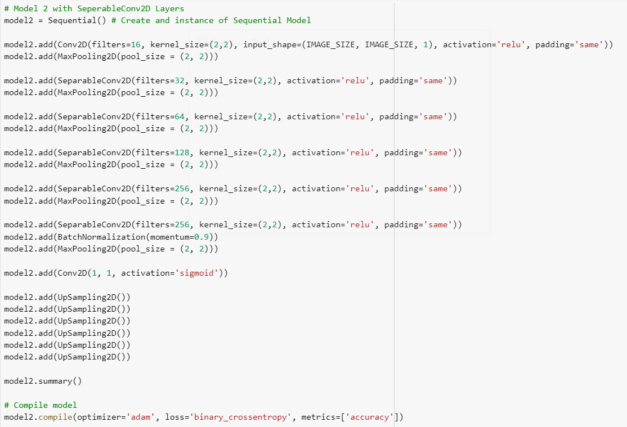
Deciding Models and Model Building
Model 2 with SeperableConv2D Layers
Training accuracy : 97.33%
Validation accuracy : 97.37%

Slide 17
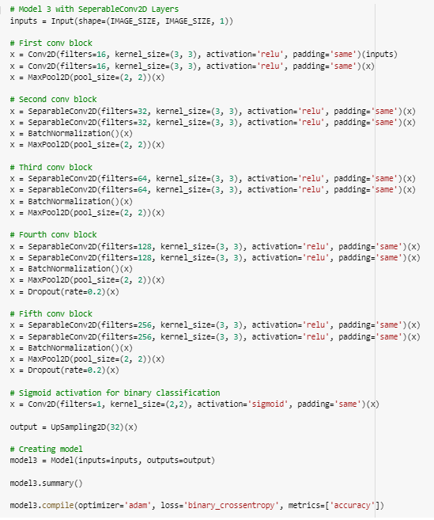
Deciding Models and Model Building
Model 3 with SeperableConv2D blocks with greater depth
depth
Training accuracy : 96.21%
Validation accuracy : 96.01%

Slide 18
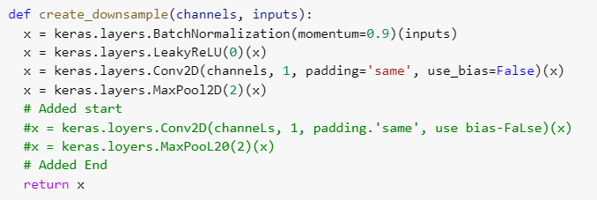
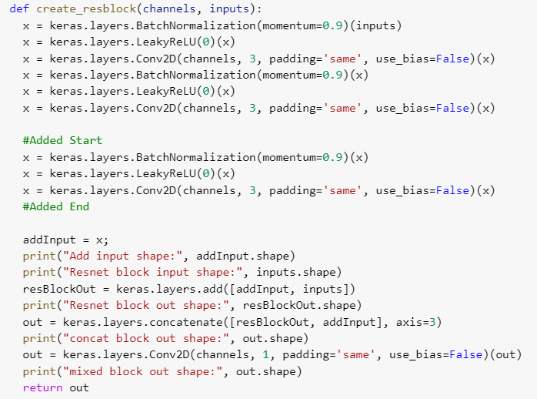
Deciding Models and Model Building
Model 4 with ResNet blocks
Training accuracy : 96.57%
Validation accuracy : 95.48%

Slide 19
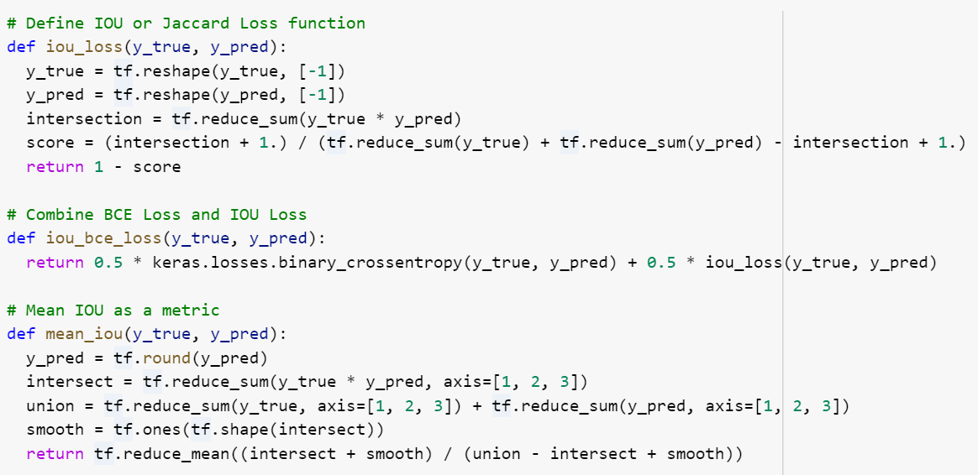
BCE + IOU as Loss Mean IOU as Metric

Slide 20
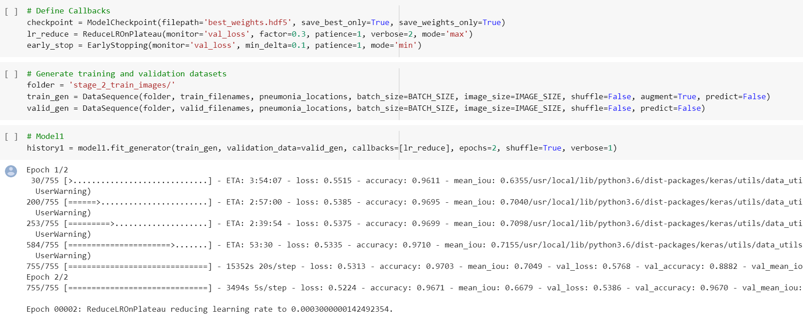
Model Training

Slide 21
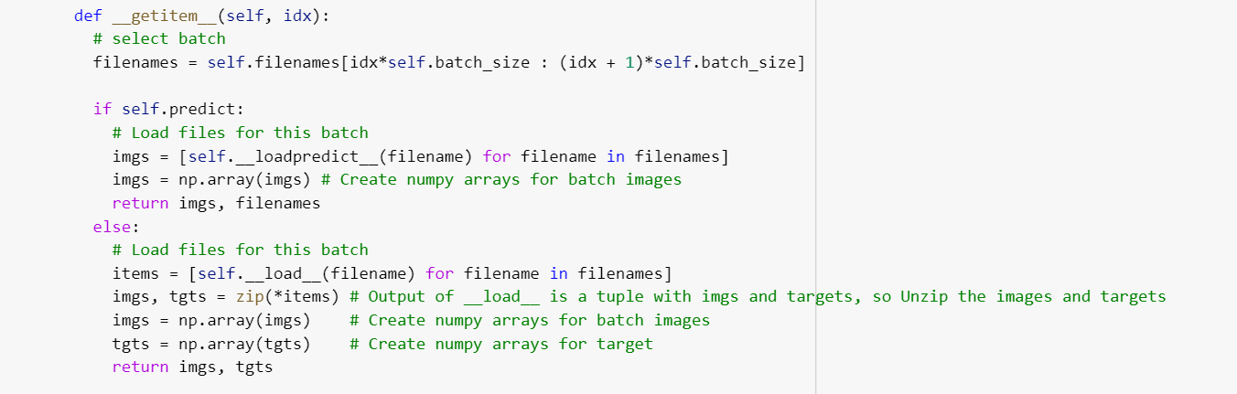
Classification Model

Slide 22
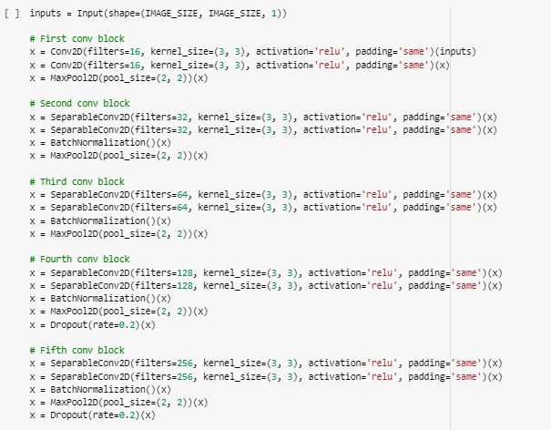
Classification Model

Slide 23
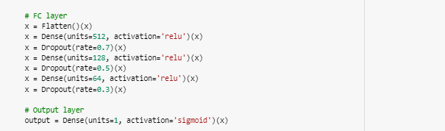
Classification Model
Training accuracy : 81.97%
Validation accuracy : 80.69%

Slide 24
Model Comparison
Model | Training accuracy | Validation accuracy | AUC
Model 1: Conv2D Layers | 97.34% | 97.55% | 82.92
Model 2: SeperableConv2D Layers | 97.33% | 97.37% | 79.32
Model 3: SeperableConv2D blocks with greater depth | 96.21% | 96.01% | 85.62
Model 4: ResNet blocks | 96.57% | 95.48% | 81.90
Classification Model | 81.97% | 80.69% | -

Slide 25
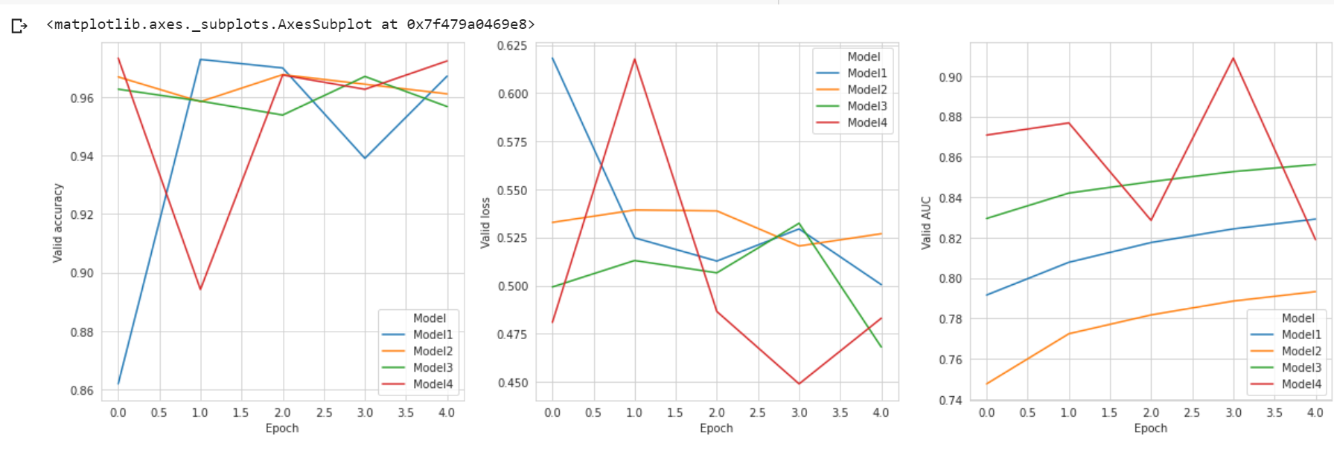
Model Comparison

Slide 26
Step by Step Approach
Pre-processing by splitting training data into batches of size 32
Created a basic model with only Conv2D layers
To reduce the training parameters, created model with SeparableConv2D
Built 4 models for predicting bounding boxes and evaluated based on Accuracy metric
Built Classification model for predicting the presence of Pneumonia
Picked model 3, SeperableConv2D blocks with greater depth, based on accuracy and loss.
Verified actual and predicted bounding boxes using 1 batch(32) of validation samples
Created submission file

Slide 27
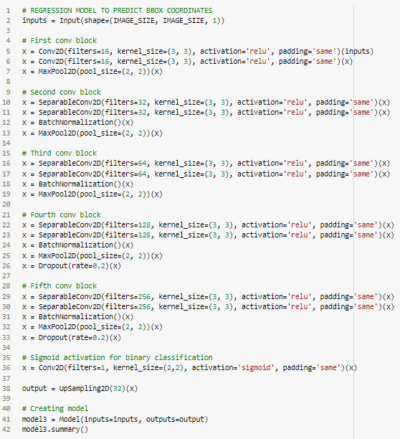
Model Evaluation
Based on AUC, Accuracy and Loss, selected model 3, SeperableConv2D blocks

Slide 28
Model Evaluation
Model Structure for Model 3
5 SeparableConv2D blocks with MaxPooling and BatchNormalization layers
Conv2D Sigmoid Activation
32 Upsampling Layers
Optimzer = Adam
Loss = iou_bce_loss
Metrics = accuracy
Epochs = 8

Slide 29
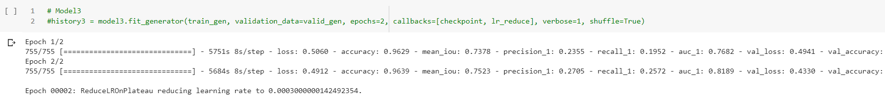
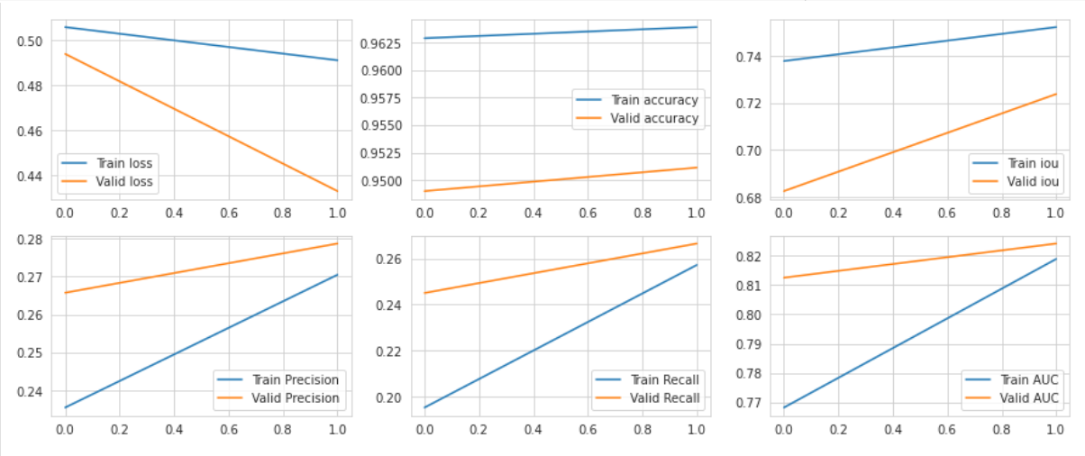
Model Evaluation

Slide 30
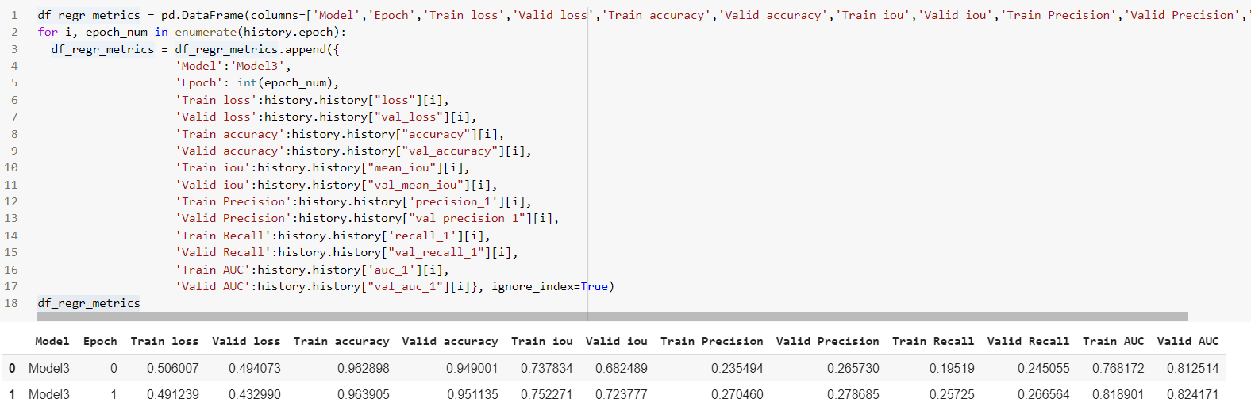
Model Evaluation
Based on accuracy and loss, selected model 3, SeperableConv2D blocks

Slide 31
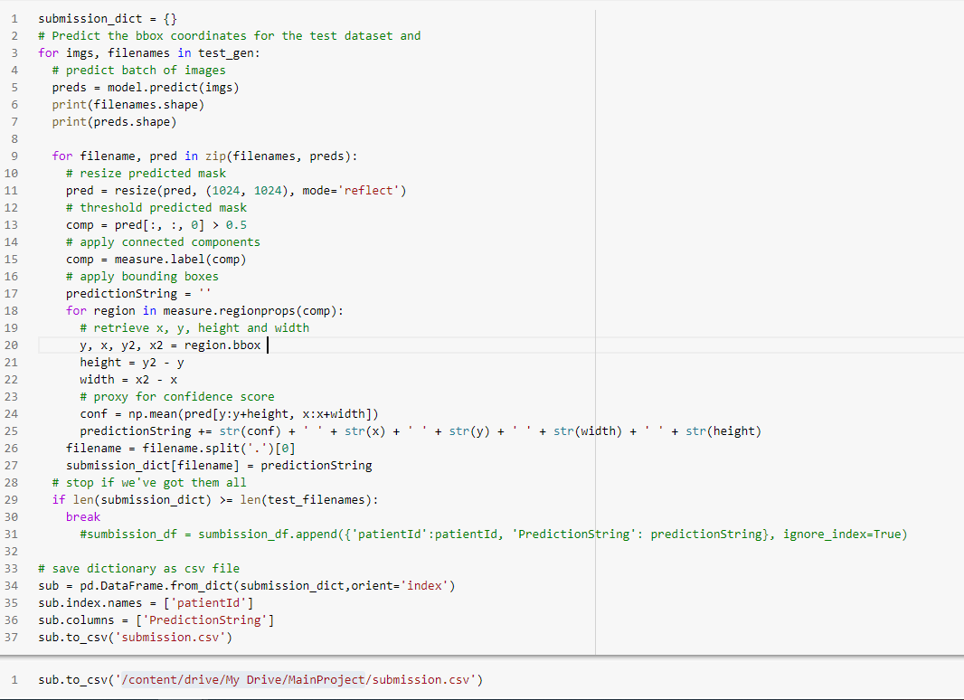
Submission File Creation

Slide 32
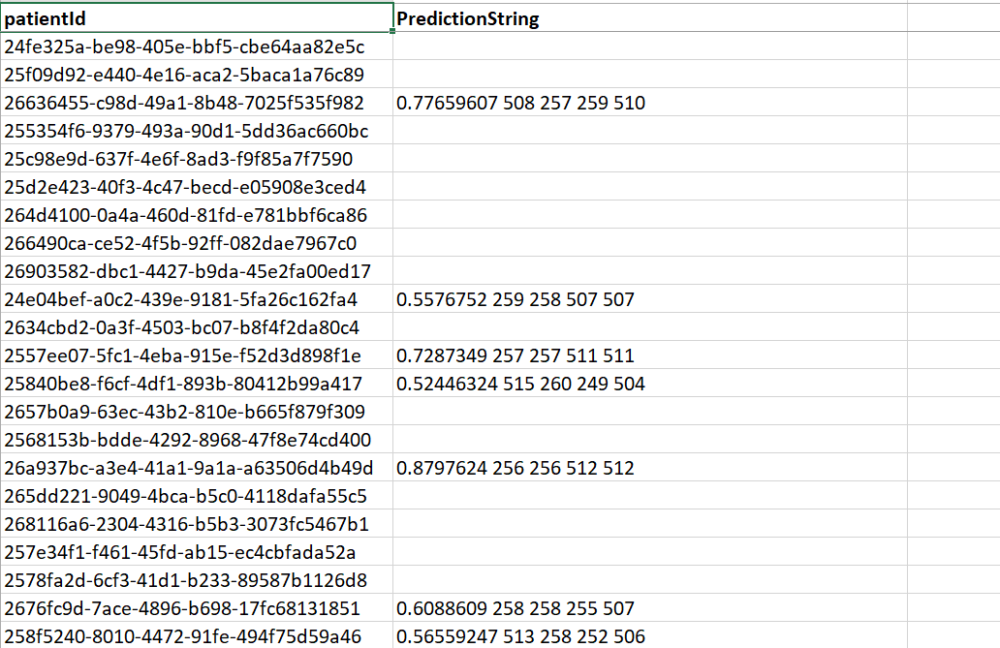
Submission File

Slide 33
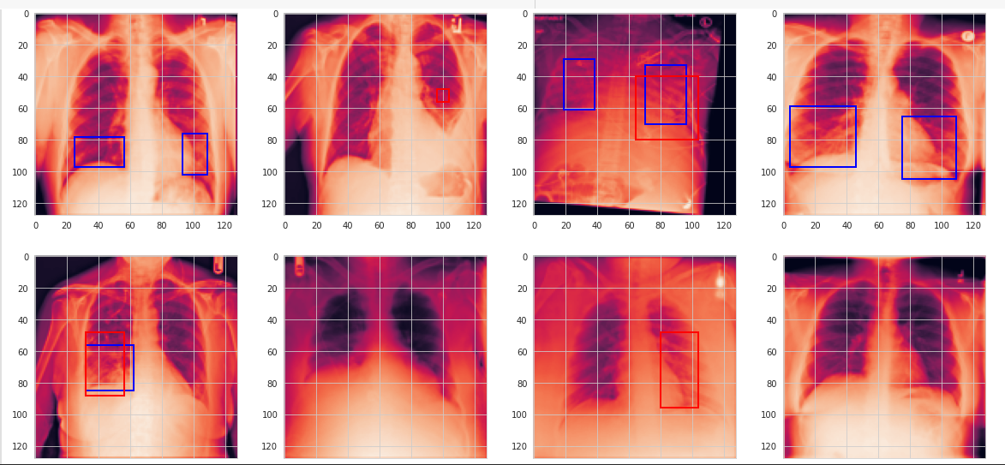
Model Output for Training Data(Model 3)
Predicted bounding box
Original bounding box

Slide 34
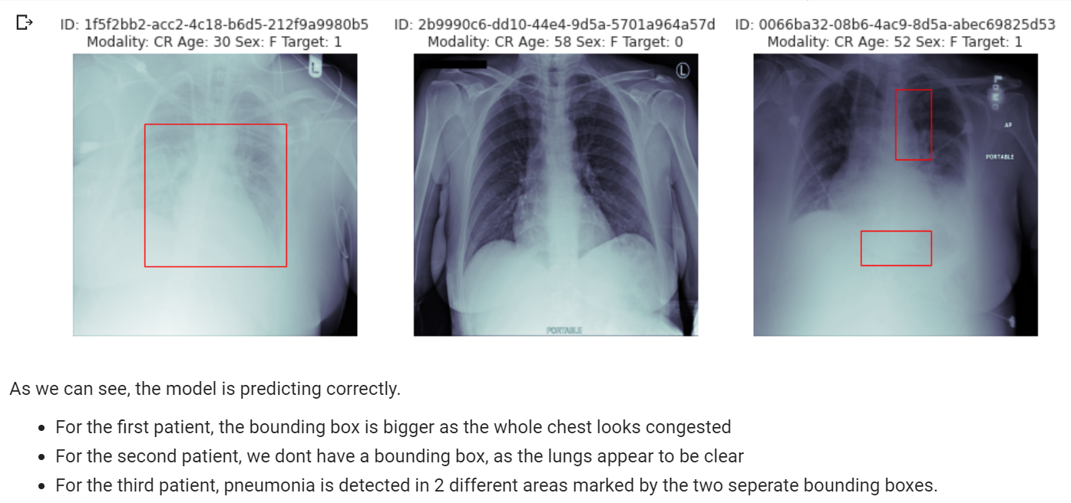
Model Output for Test Data(Model 3)
Predicted bounding box

Slide 35
Conclusion
Our model is able to predict the bounding boxes around Pneumonic patches with accuracy of 87% on test data.
Out of 3000 patients in the test set, 935 appear to have pneumonia for whom one or more bounding boxes are predicted by our model.
Approximately 31% of patients are predicted to have pneumonia which is consistent with the training set data.
This project uses recent techniques in the field of computer vision and deep learning and visualizations of key outcomes.

Slide 36
Implications
Application can predict if the patient is affected with Pneumonia
It pinpoints the affected areas of lungs using bounding boxes and the confidence levels associated with each of them
This will help the doctors by reducing the number of CXRs they have to look through
This project will help health care professionals by making quick and accurate predictions of pneumonia in CXR images.

Slide 37
Limitations
Currently, input images size is fixed. This can be modified to accept images of different sizes.

Slide 38
How to improve model performance?
Image Augmentation to increase the number of images where Target=1, which is our class of interest
Increase the number of training epochs
Choose models based on performance

Slide 39
Closing Reflections
Learnings
Use of pydicom package to view .dcm medical images
Preprocessing of image related data
Use of custom loss and metric functions
Resnet and SeperableConv2D Layers
Collaboration between team members for different tasks
Understanding of complexity of real-world data and projects
Possible Improvements
Use a pretrained model such as YOLO or Faster-RCNN as benchmark
Image Augmentation

Slide 40
Thank you!

